Slide 1
Scaling with PostgreSQL
Magic of Tuning and Connection Pooling

Slide 2
Pitfalls where IT Mangers get Trapped
Failure to have a correct plan for scaling with business
Falling prey to proprietary database vendors and their costly hardware
Failing to identify the correct Core-Memory Ratio
Adding Resources will not help all the time

Slide 3
Benchmark Studies: Objective
See how PostgreSQL scales with hardware
See how PostgreSQL scales with tuning
See the effect of proper Connection and Transaction Management on PostgreSQL performance
Highlight the importance of Tuning despite increasing system hardware

Slide 4
Benchmark Studies: Test bed Setup
We have used HammerDB for this benchmark
An open source benchmarking tool which provides test cases for TPC-C and TPC-H benchmarks
We used TPC-C for our tests
All the tests were run on a Virtual Machine (using VM player) on a Laptop
64-bit Intel 8 core CPU
16 GB of physical memory
Host OS- Windows 7 64 bit
Testing Environment
Postgres Plus Advanced Server v9.2
Running on Red Hat Enterprise Linux v6.1 (with kernel version 2.6)

Slide 5
Disclaimer
Performance without tuning and with tuning is shared here to make a point
The tests were done on a virtual environment running on a low end host machine
Scalability or raw performance numbers presented here are not true indicators of capabilities of PostgreSQL/Postgres Plus Advanced Server
With the real server class machines these numbers would be much higher than on the test machine

Slide 6
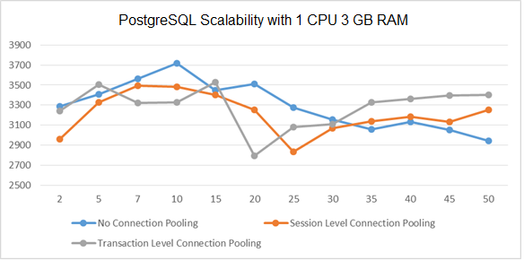
Low Configuration PostgreSQL server scaling with Connection Pooling
Database Parameters:
No of Processors: 1
Memory: 3GB,
shared_buffer: 32MB,
effective_cache_size: 128MB
work_mem=1MB
Key Learning:
Test 1
- The performance degrades once the load increases beyond a point [sounds familiar?]
Test 2
- Session Level Connection pooling with max 50 connections in Pool
- Connections aquired as needed so not much difference than first test
Test 3
- Transaction Level Connection Pooling with 25 connections
- Does well as concurrency increases [scaling with growth!!!]
Inconsistent/low and highs can be attributed to resources contention during autovacuum

Slide 7
Some Important Parameters for Tuning in PostgreSQL
shared_buffer
effective_cache_size
work_mem
wal_buffer
bgwriter_delay
effective_io_concurrency
checkpoint_segment
checkpoint_timeout
random_page_cost
autovacuum_naptime
autovacuum_vacuum_threshold
autovacuum_analyze_threshold
autovacuum_vacuum_scale_factor
autovacuum_analyze_scale_factor
autovacuum_vacuum_cost_delay

Slide 8
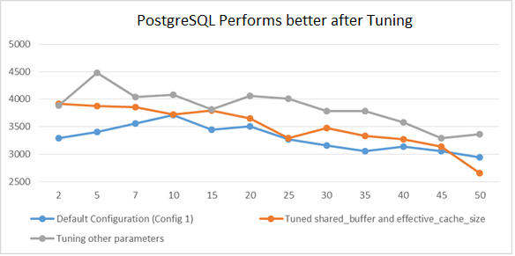
PostgreSQL Performs better after Tuning
Database Parameters:
No of Processors: 1
Memory: 3GB,
shared_buffer: 32MB/256MB,
effective_cache_size: 128MB/750MB
work_mem=1MB
Key Learning:
Test 1: Basic Setup
- The performance degrades once the load increases beyond a point [sounds familiar?]
Test 2: Tuned postgresql.conf for shared_buffer and effective_cache_size
- Up to 19% gain over basic configuration
Test 3: Tuned other parameters in postgresql.conf
- Up to 21% gain
- The occasional performance troughs because of vacuum operation is not there anymore
Still the performance is not scalable in any of the 3 cases and degrades with concurrency [25-30% loss]

Slide 9
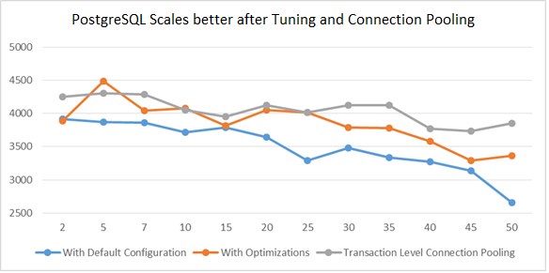
Combining the Effect of Connection Pooling and Tuning
Database Parameters:
No of Processors: 1
Memory: 3GB,
shared_buffer: 256MB,
effective_cache_size: 750MB
work_mem=1MB
Key Learning:
Test 1: Basic Setup with tuned shared_buffer and effective_cache_size
- The performance degrades once the load increases beyond a point [sounds familiar?]
Test 2: Tuned other parameters in postgresql.conf
- Performance gain of up to 14%
- The performance continues to degrade [by a margin of 26%] at higher concurrency
Test 3: Transaction Level Connection Pooling
- Performance is more consistent
- Degradation/loss in performance at peak concurrency is quite less [14% only]
Finally we get a consistently scaling Database Setup

Slide 10
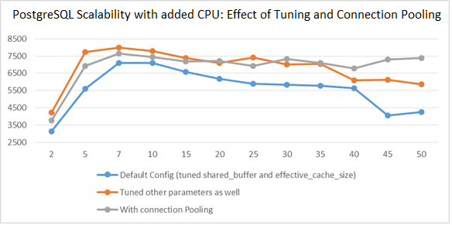
Tuning and proper Transaction Management enhances the benefit of CPU addition
Database Parameters:
No of Processors: 2
Memory: 3GB,
shared_buffer: 256MB,
effective_cache_size: 750MB
work_mem=1MB
Key Learning:
Test 1: Basic Setup with tuned shared_buffer and effective_cache_size
- The performance degrades once the load increases beyond a point
Test 2: Tuned other parameters in postgresql.conf
- Performance gain of 36% at Peak load
- The performance continues to degrade [by a margin of 26%] at higher concurrency
Test 3: Transaction Level Connection Pooling
- Performance is more consistent
- Improvement caused by tuning is more prominent with boosted computing [1CPU- 46% | 2CPU- 80%]
Even after boosting computing power, to get best of resources, tuning and connection pooling plays a major role

Slide 11
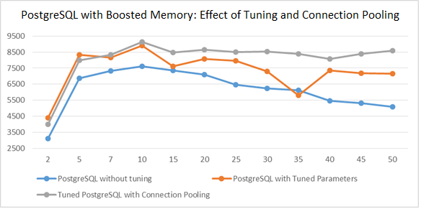
Tuning and proper Transaction Management enhances the benefit of Memory Upgrade
Database Parameters:
No of Processors: 2
Memory: 4.5GB,
shared_buffer: 750MB,
effective_cache_size: 2GB
work_mem=1MB
Key Learning:
Test 1: Basic Setup with tuned shared_buffer[750MB] and effective_cache_size[2GB]
- The performance degrades once the load increases beyond a point
Test 2: Tuned other parameters in postgresql.conf
- Performance gain of 55% at Peak load
- The performance continues to degrade [by a margin of 15%] at higher concurrency
Test 3: Transaction Level Connection Pooling
- Performance is more consistent
- Gain with additional memory is more prominent after tuning and connection pooling
To make best use of added memory tuning and connection pooling are important

Slide 12
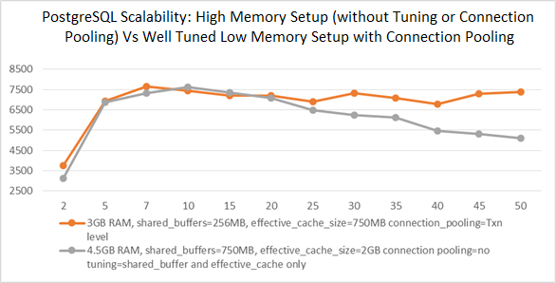
Low Memory Tuned Postgres Vs Un-Tuned Postgres with Higher Memory
Database Parameters:
No of Processors: 2
Memory: 3GB/4.5GB,
shared_buffer: 256MB/750MB,
effective_cache_size: 750MB/2GB
work_mem=1MB
Key Learning:
Test 1: Un-tuned PostgreSQL [only shared_buffer and effective_cache_size is tuned] with 4.5 GB RAM
- The performance continues to degrade [by a margin of 38%] at higher concurrency
Test 3: Tune PostgreSQL with Transaction Level Connection Pooling
- Performance is more consistent
- Despite low memory, performance is comparable at low concurrency
- A Tuned database with proper transaction management does better as load increases
Most of your performance issues can be resolved with proper application and database tuning

Slide 13
Ashnik Message
You don’t always need a high end system in the beginning to scale in future
There are commercially supported Open Source Solutions available which scale as good as their proprietary counterparts
There is no generic core-memory formula- Our consultants help customers identify what is best for them
A well designed application with a well tuned database can work better than a un-optimized database on a high end server

Slide 14
How Ashnik Helps?
Server sizing
Health Check contracts on half yearly and annual terms
On-demand Health Check and Tuning services
Provide in migration services- $$ Saving by migrating from costly proprietary database solutions

